Slide 1
Demonstrating Pythagoras' theorem
Geometrical properties: similarity and Pythagoras' theorem

Slide 2
how to use Oak lessons

Slide 3
I can appreciate there is a relationship between the lengths of the sides of a right-angled triangle.

Slide 4
Pythagoras’ theorem shows that the sum of the squares of the two shorter sides of a right-angled triangle is equal to the square of its longest side (the hypotenuse).

Slide 5

Demonstrating Pythagoras' theorem
Creating triangles from combinations of squares
Properties from summing the areas of squares

Slide 6
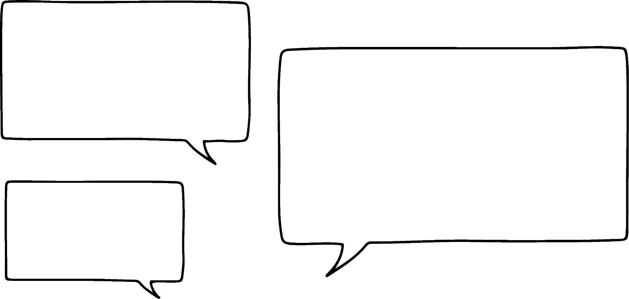
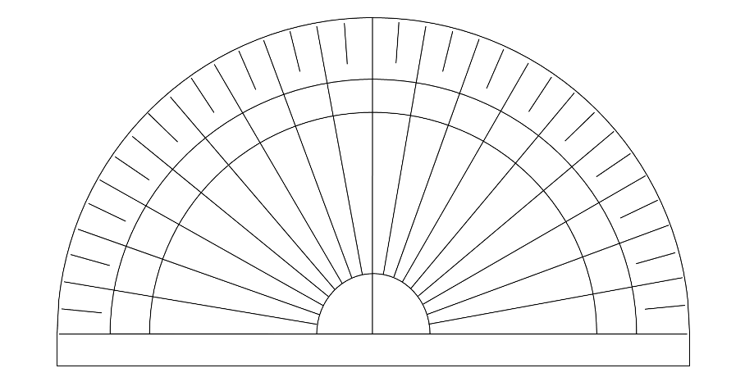


Creating triangles from combinations of squares
I can create a triangle by joining up some vertices of three squares, like this.
Hmm, let me get a protractor to check!
It looks like it’s an equilateral triangle to me.
Lucas
60°
60°
I see it!
The triangle is in that middle space between the squares.
I wonder what type of triangle that is.
Alex

Slide 7

Creating triangles from combinations of squares
I can create a triangle by joining up some vertices of three squares, like this.
Oh, true! I wonder if you can make different triangles with three squares of different areas.
Hmm, let me get a protractor to check!
It looks like it’s an equilateral triangle to me.
Lucas
60°
60°
But isn’t that obvious, since all three squares you used are congruent, and so they all have the same area!
You’re right, it is an equilateral triangle…
Laura

Slide 8
Creating triangles from combinations of squares
This triangle is made from two squares with an area of 20 cm², and one square with an area of 4 cm².
Lucas
What type of triangle has Lucas made?
an isosceles triangle

Slide 9


Creating triangles from combinations of squares
What type of triangle is made from these three squares joined at their vertices?
5 cm²
an isosceles triangle
5 cm²
Which of these explanations justifies how you know?
18 cm²
a
the square with the largest area is more than double the size of one of the smaller squares
b
there are two squares of equal area
c
each square is made from right angles

Slide 10
Creating triangles from combinations of squares
The three angles in this triangle are 115°, 30°, and 35°.
What type of triangle is this?
a scalene triangle
What do you know about the three squares from this information?
a
the areas of the three squares are all different
b
the three squares are congruent
c
each square has a different side length
d
each square has the same side length

Slide 11

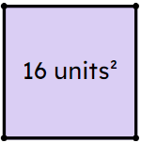

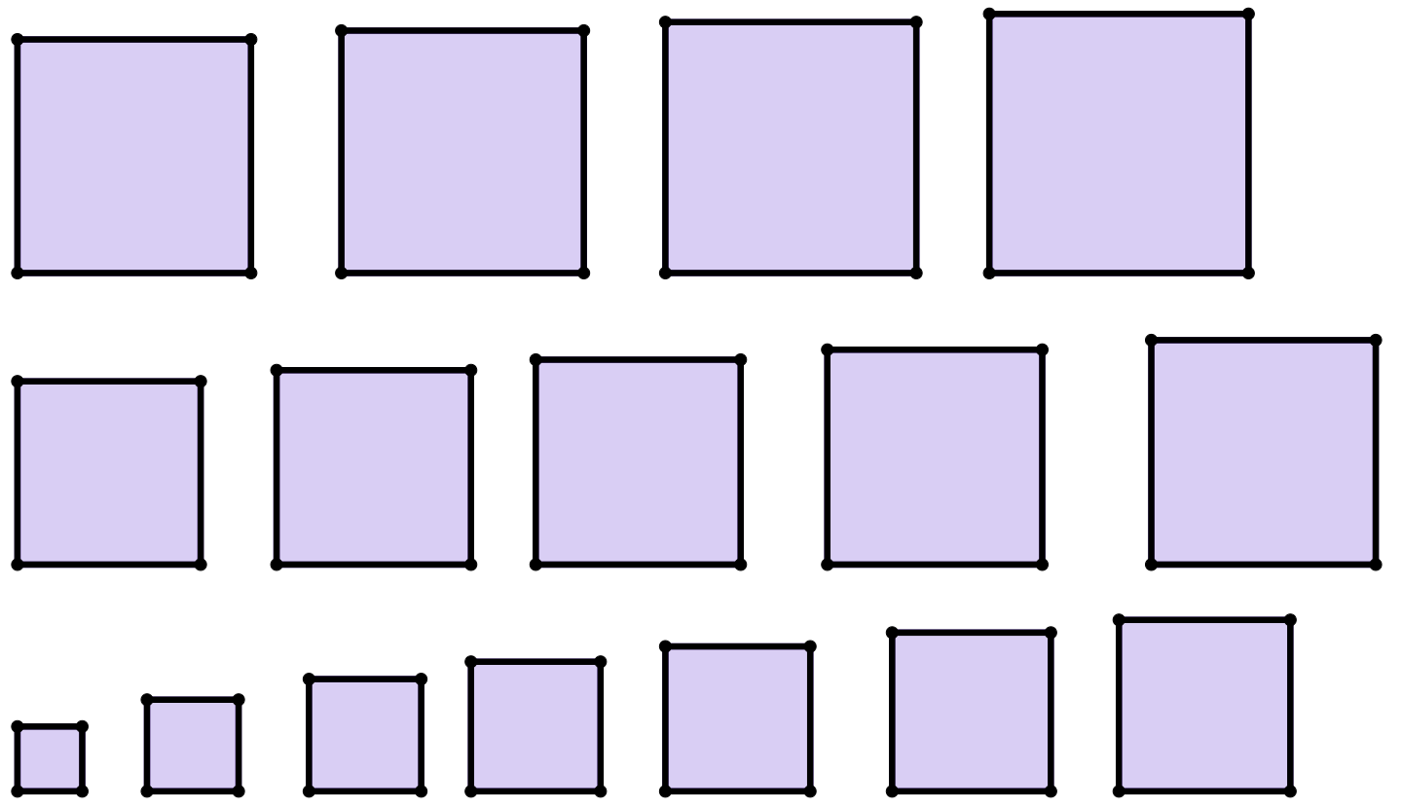
Creating triangles from combinations of squares
You will need the squares cut out accurately.
1) Create a triangle by joining the vertices of the squares with areas of 1 unit², 3 units², and 5 units².
Using a protractor, measure the size of each angle in this triangle.
3 units²
1
5 units²
2) Explain why you cannot create an equilateral triangle using a combination of the squares you have been given.

Slide 12
Creating triangles from combinations of squares
3) Two triangles can be created by joining the vertices of the following:
- squares with areas of 2 units², 5 units², 6 units² (triangle X)
- squares with areas of 4 units², 10 units², 12 units² (triangle Y)
a) Create these two triangles and measure each of their angles with a protractor.
b) Write down what you notice about the angles between each of these triangles. Can you explain your observations?
4) Create a triangle that is similar, but not congruent, to a triangle made from squares with areas 21 units², 27 units², 39 units².

Slide 13
Creating triangles from combinations of squares
5) Create 3 isosceles triangles from the following:
- squares with areas of 4 units², 4 units², 12 units² (triangle A)
- squares with areas of 6 units², 6 units², 12 units² (triangle B)
- squares with areas of 1 units², 8 units², 8 units² (triangle C)
a) Measure the largest angle of each triangle with a protractor.
b) Which triangle has as its largest angle:
- an acute angle
- a right angle
- an obtuse angle

Slide 14
Creating triangles from combinations of squares
areas of the three squares | largest angle
7, 10, 13 | acute
4, 5, 11
4, 9, 13
6) Complete the table by joining three squares and writing down whether the largest angle is: acute, obtuse, or right.
After choosing three squares, can you predict what type of angle you’ll get before you join up the squares?

Slide 15
Creating triangles from combinations of squares
1) Create a triangle by joining the vertices of squares with area of 1 unit², 3 units², and 5 units².
Using a protractor, measure the size of each angle in this triangle.
3 units²
1
5 units²
angles of approximately
25°, 48°, and 107°
2) With the squares you’ve been given, explain why you cannot create an equilateral triangle.
There is only a maximum of two copies of each set of congruent squares (squares with the same area), and you need three congruent squares to create an equilateral triangle.

Slide 16
Creating triangles from combinations of squares
3) Two triangles can be created by joining the vertices of the following:
- squares with areas of 2 units², 5 units², 6 units² (triangle X)
- squares with areas of 4 units², 10 units², 12 units² (triangle Y)
a) Create these two triangles and measure each of their angles with a protractor.
b) Write down what you notice about the angles between each of these triangles. Can you explain your observations?
angles of approximately 35°, 64°, and 81° for both triangles
The triangles are similar to each other as their angles are the same. (Minor differences in measurement may occur due to accuracy of equipment.) Did you notice that the squares that make up triangle Y are twice the area of the squares from triangle X?

Slide 17
Creating triangles from combinations of squares
4) Create a triangle that is similar to a triangle made from squares with areas 21 units², 27 units², 39 units². Which squares did you use?
7 units², 9 units², and 13 units².

Slide 18
Creating triangles from combinations of squares
5) Create 3 isosceles triangles from the following squares:
- 4 units², 4 units², 12 units² (triangle A)
- 6 units², 6 units², 12 units² (triangle B)
- 1 units², 8 units², 8 units² (triangle C)
a) Measure the largest angle of each triangle with a protractor.
b) Which triangle has as its largest angle:
- an acute angle?
- a right angle?
- an obtuse angle?
A: 120°
B: 90°
C: 80°
C
B
A

Slide 19
Creating triangles from combinations of squares
areas of the three squares | largest angle
7, 10, 13 | acute
4, 5, 11 | obtuse
4, 9, 13 | right angle
3, 10, 13 | right angle
5, 6, 7 | acute
6) Complete the table by joining three squares and writing down whether the largest angle is: acute, obtuse, or right.
After choosing three squares, can you predict what type of angle you’ll get before you join up the squares?
Did you come up with a theory for a relationship between the areas and the size of the largest angle?
Let’s find out if your theory is correct…
There are many possible triangles that could have been created from different combinations of squares.

Slide 20
Demonstrating Pythagoras' theorem
Creating triangles from combinations of squares
Properties from summing the areas of squares

Slide 21
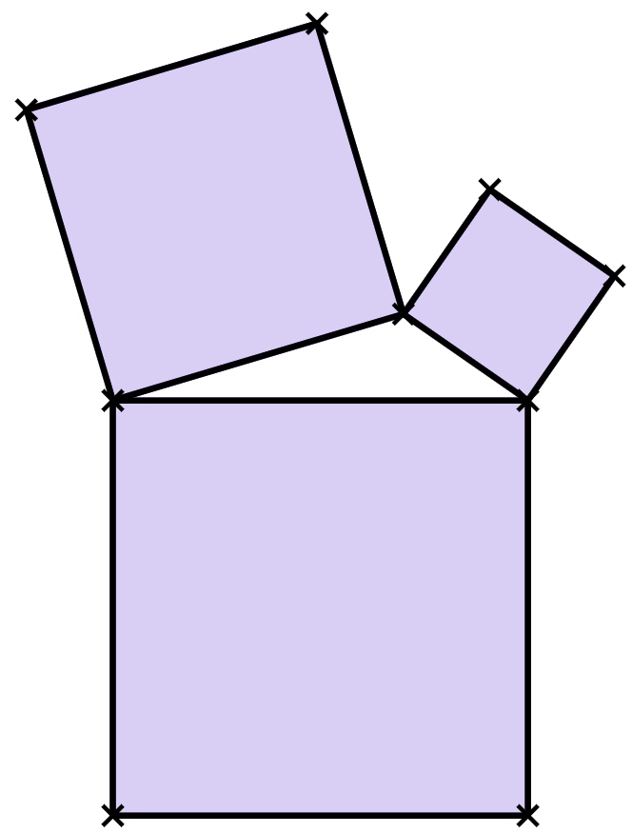
Properties from summing the areas of squares
So, depending on the squares we choose, we can make different triangles with different types of angles.
obtuse angle
8 units²
2 units²
Lucas
I wonder if there’s a pattern in the squares that we choose and the type of angle that’s largest in the triangle!
15 units²
Alex

Slide 22
Properties from summing the areas of squares
Maybe there is a pattern.
Here are some of my answers to a previous task.
areas of the three squares | largest angle
7, 10, 13 | acute
4, 7, 9 | acute
4, 4, 7 | acute
3, 5, 10 | obtuse
5, 7, 14 | obtuse
1, 3, 7 | obtuse
3, 8, 11 | right-angle
2, 5, 7 | right-angle
4, 8, 12 | right-angle
Laura
Can you spot a pattern in the areas of the squares that make each type of angle?

Slide 23
Properties from summing the areas of squares
areas of the three squares | largest angle
7, 10, 13 | acute
4, 7, 9 | acute
4, 4, 7 | acute
3, 5, 10 | obtuse
5, 7, 14 | obtuse
1, 3, 7 | obtuse
3, 8, 11 | right-angle
2, 5, 7 | right-angle
4, 8, 12 | right-angle
7 + 10
= 17
4 + 7
= 11
If you take the two smaller areas,
I think I’ve spotted a pattern in the triangles whose largest angle is acute!
and sum them together,
the largest square has an area smaller than this sum.
Alex

Slide 24
Properties from summing the areas of squares
areas of the three squares | largest angle
7, 10, 13 | acute
4, 7, 9 | acute
4, 4, 7 | acute
3, 5, 10 | obtuse
5, 7, 14 | obtuse
1, 3, 7 | obtuse
3, 8, 11 | right-angle
2, 5, 7 | right-angle
4, 8, 12 | right-angle
7 + 10
= 17
13 is less than 17.
4 + 7
= 11
9 is less than 11.
Oh wow! Well spotted.
I wonder if there is a similar pattern if the largest angle is obtuse or right-angled.
Can you spot a pattern?
Laura

Slide 25
Properties from summing the areas of squares
Exploration 🖇
Can you spot what happens to the largest angle when you compare the size of the two smaller areas to the size of the largest area?
Alex

Slide 26
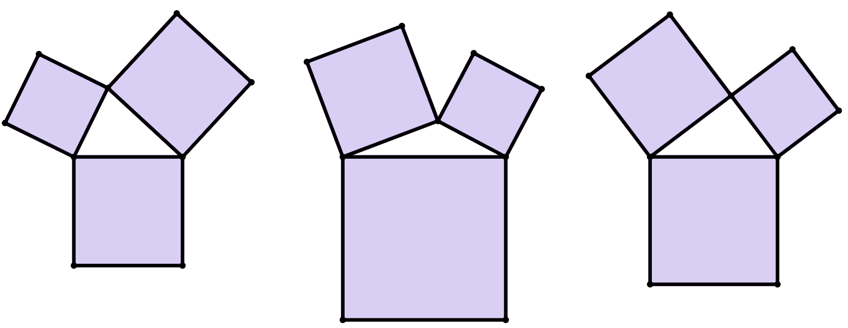
Properties from summing the areas of squares
7 units²
7 units²
7 + 4 = 11
4
units²
7 + 4 = 11
4
units²
8 is less than 11.
18 is greater than 11.
18 units²
8 units²
obtuse
acute
If the area of the largest square is less than the sum of the two smaller areas…
If the area of the largest square is greater than the sum of the two smaller areas…
The largest angle is always acute.
The largest angle is always obtuse.

Slide 27
Properties from summing the areas of squares
But what about a right-angled triangle?
7 units²
4
units²
What’s the relationship between:
the areas of the two smaller squares
the area of the larger square?
11 units²
If the area of the largest square is equal to the sum of the two smaller areas…
7 + 4 = 11
The largest angle is always right-angled.
11 units² is the area of the largest square.

Slide 28
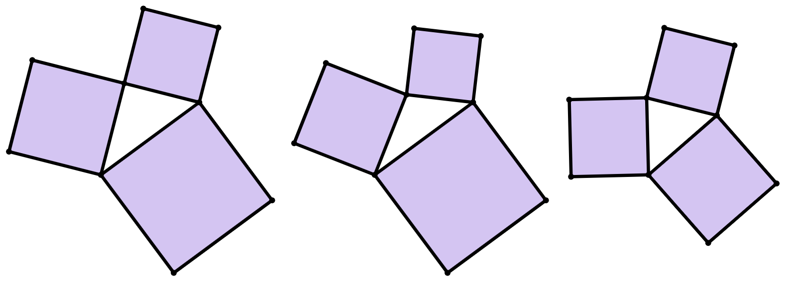
Properties from summing the areas of squares
a
8
units²
b
6
units²
7
units²
c
12 units²
10
units²
8
units²
20 units²
20 units²
11 units²
obtuse
acute
right-angled
12 + 8 = 20
10 + 6 = 16
8 + 7 = 15
In which of these triangles is the largest angle (marked with an angle marker): acute, obtuse, right-angled?

Slide 29
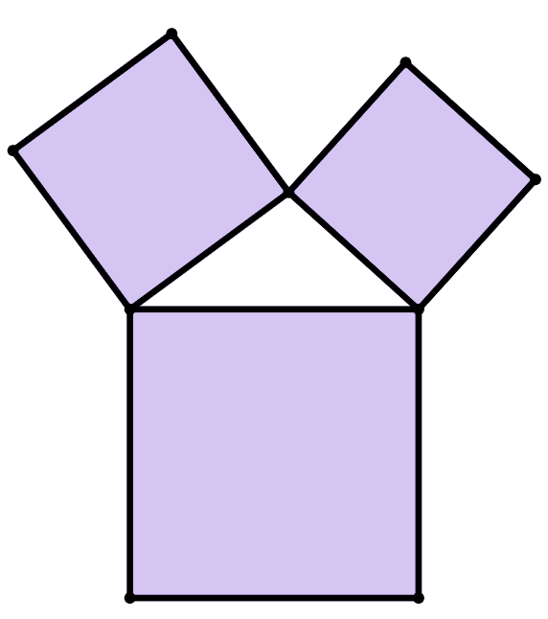
Properties from summing the areas of squares
The largest angle of this triangle is an obtuse angle.
Which of these are possible values of x units², the area of the largest square?
14 units²
11 units²
a
11 units²
d
25 units²
x units²
b
13 units²
e
30 units²
c
14 units²
f
36 units²

Slide 30
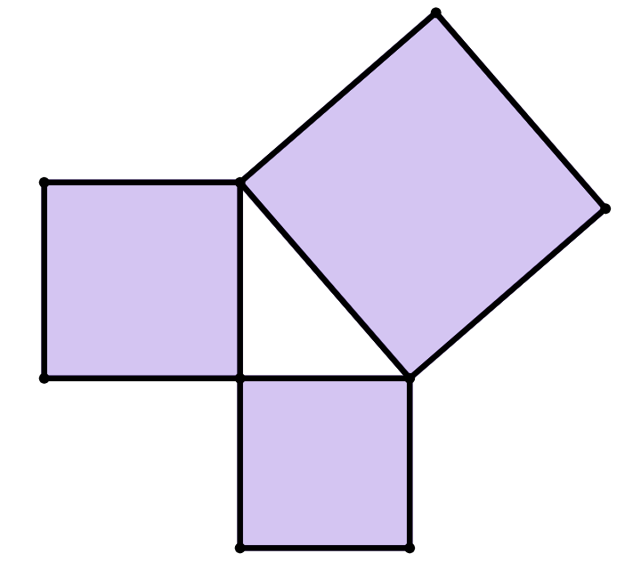
Properties from summing the areas of squares
The largest angle of this triangle is a right angle.
What must be the value of y, where y units² is the area of the largest square?
16 units²
y units²
12 units²
28

Slide 31
Properties from summing the areas of squares
Is there an easier way of spotting where the largest angle is on the triangle?
The largest angle never seems to touch the largest square.
Maybe the largest angle is always opposite the largest square.
I think you’re right!
It’s definitely true for all of these triangles!
For some triangles, it’s tricky without using a protractor.
Alex
7 units²
9 units²
5
units²
4
units²
16 units²
Laura
28 units²
8 units²
14 units²
12 units²

Slide 32
Properties from summing the areas of squares
As the biggest square gets larger, the largest angle opposite it also gets larger!
Alex

Slide 33
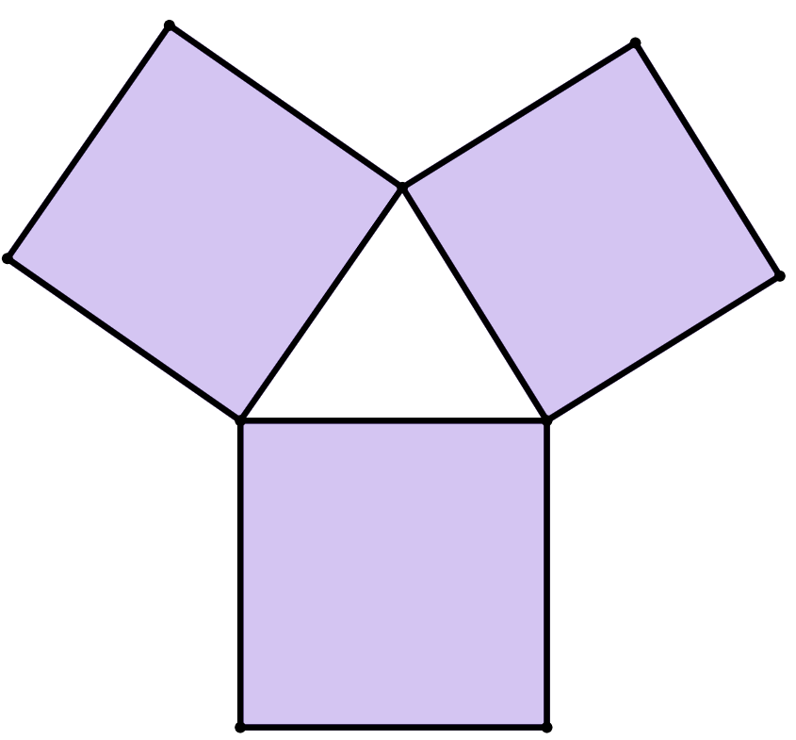
Properties from summing the areas of squares
In this triangle, which of its three angles is the largest?
30 units²
b°
c°
b°
35 units²
28 units²
a°

Slide 34
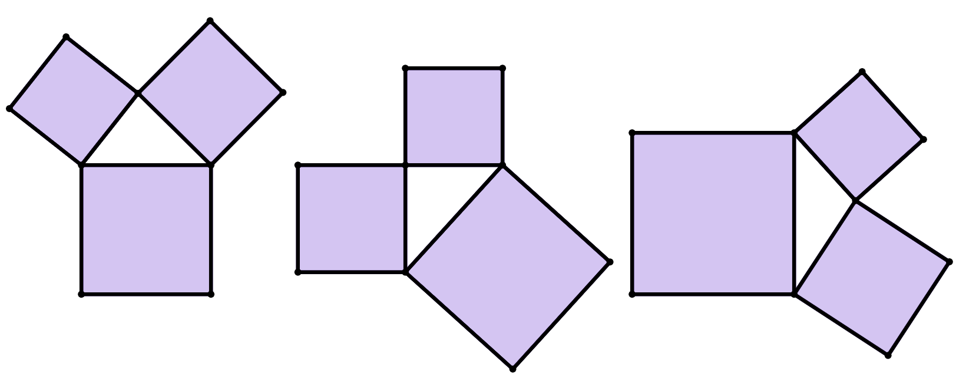
Properties from summing the areas of squares
1) For each of these triangles, draw on an angle marker at the largest interior angle of the triangle.
For each angle marked, write down whether it is acute, right, or obtuse.
a)
8
units²
10
units²
9
units²
c)
8
units²
b)
16 units²
11
units²
25
units²
20
units²
12
units²

Slide 35
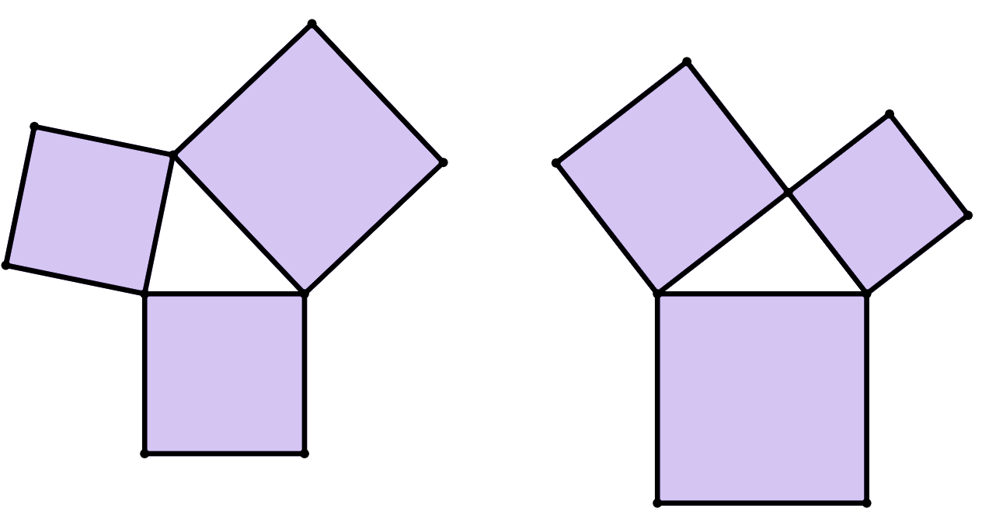
Properties from summing the areas of squares
2) The largest angle in this triangle is marked with an angle marker and is acute.
Write down a possible area of the largest square.
3) The largest angle in this triangle is a right angle.
Write down the area of the unlabelled square.
15
units²
11
units²
14
units²
24
units²

Slide 36
Properties from summing the areas of squares
4) Each group shows the areas of three squares whose vertices are joined to create a triangle.
Place each group into the correct part of the table that describes the size of its largest angle.
largest angle is acute | largest angle is obtuse | largest angle is right
16, 18, 20 | 9, 13, 26 | 8, 13, 21
3, 3, 5
1, 1, 3
4, 7, 10
16, 17, 40
8, 17, 25
9, 16, 25
5x, 7x, 12x
14a, 19a, 44a

Slide 37
Properties from summing the areas of squares
1) For each of these triangles, draw on an angle marker at the largest interior angle of the triangle.
For each angle marked, write down whether it is acute, right, or obtuse.
a)
8
units²
10
units²
9
units²
c)
8
units²
b)
16 units²
11
units²
25
units²
20
units²
12
units²
right-angled
obtuse
acute

Slide 38
Properties from summing the areas of squares
2) The largest angle in this triangle is marked with an angle marker and is acute.
Write down a possible area of the largest square.
3) The largest angle in this triangle is a right angle.
Write down the area of the unlabelled square.
15
units²
9
units²
11
units²
Any area greater than 14 units², but less than 25 units².
14
units²
24
units²

Slide 39
Properties from summing the areas of squares
4) Each group shows the areas of three squares whose vertices are joined to create a triangle.
Place each group into the correct part of the table that describes the size of its largest angle.
largest angle is acute | largest angle is obtuse | largest angle is right
16, 18, 20 | 9, 13, 26 | 8, 13, 21
3, 3, 5
1, 1, 3
8, 17, 25
4, 7, 10
16, 17, 40
9, 16, 25
14a, 19a, 44a
5x, 7x, 12x

Slide 40
Demonstrating Pythagoras' theorem
Three squares can be joined together at their vertices to create a triangle.
If three congruent squares are joined together, the triangle is equilateral.
If two congruent squares are joined together, the triangle is isosceles.
If all squares have different areas, the triangle is scalene.
The largest angle of the triangle can either be acute, right, or obtuse, depending on whether the sum of the areas of the two smaller squares is greater than, equal to, or less than the area of the largest square, respectively.
When the sum of the areas of the two smaller squares is equal to the area of the largest square, the triangle is always a right-angled triangle. This is a visual demonstration of Pythagoras’ theorem.

Slide 41

© Oak National Academy 2024.
Produced in partnership with Mathematics in Education and Industry.
Licensed on the Open Government Licence v3.0, except where otherwise stated. See Oak terms and conditions.

